Slide 1
Lakeflow Spark Declarative Pipelines with Auto CDC

Slide 2
Lakeflow Spark Declarative Pipelines
SDP in Databricks is a declarative framework for building and running batch and streaming data pipelines using SQL or Python.
It extends Apache Spark Declarative Pipelines but runs on the performance-optimized Databricks Runtime, integrating tightly with Unity Catalog and Databricks SQL.
Instead of manually orchestrating Spark jobs, you declare the desired data transformations and outputs (tables, views, sinks), and SDP automatically handles execution order, parallelism, incremental processing, and failure retries.
Dependency on Databricks serverless compute
Demo is using Databricks streaming tables
Currently we are using UAPI for data transformations

Slide 3
Lakeflow Spark Declarative Pipelines
Main Concepts
Flows – Core processing units (batch or streaming) that read from sources, apply logic, and write to targets.
Streaming Tables – Unity Catalog managed tables with continuous ingestion (Append or AUTO CDC).
Materialized Views – Batch targets that process only new/changed data.
Sinks – External streaming targets like Delta tables, Kafka, EventHubs, or custom Python outputs.
Pipelines – The top-level execution unit containing flows, tables, views, and sinks.

Slide 4
Lakeflow Spark Declarative Pipelines
Key Benefits
Automatic orchestration of flows with retries at task, flow, and pipeline levels.
Declarative processing that reduces complex Spark/Structured Streaming code to a few lines.
Incremental processing for materialized views to avoid reprocessing unchanged data.
Built-in CDC handling via AUTO CDC for SCD Type 1 & 2 without manual watermark/event ordering logic.

Slide 5
Universal Application Programming Interface
UAPI
A Unified API is an innovative type of application programming interface (API) designed to empower developers with seamless access to information from multiple sources through a single interface. In simpler terms, a unified API streamlines and accelerates the process of fetching data from diverse databases, applications, systems, and even different APIs.

Slide 6
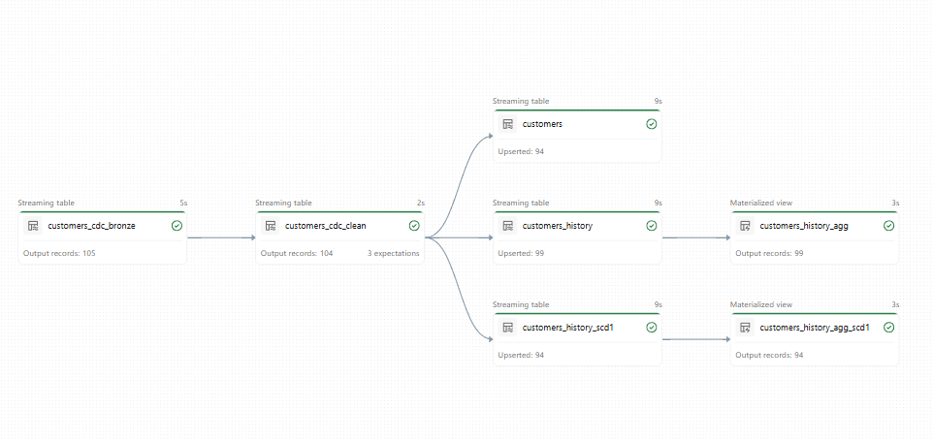
Data flow
SCD2
SCD1

Slide 7
Lakeflow Declarative pipelines
Demo

